Slide 1
Horovod Distributed Polar Sea-Ice Classification over Sentinel-2 Imagery
Jurdana Masuma Iqrah
Department of Computer Science
University of Texas at San Antonio
Department of Computer Science
Notes:
Hi everyone,
Good afternoon,
This is Jurdana masuma iqrah
Today im going to present my doctoral dissertation proposal on “polar sea ice…….)

Slide 2
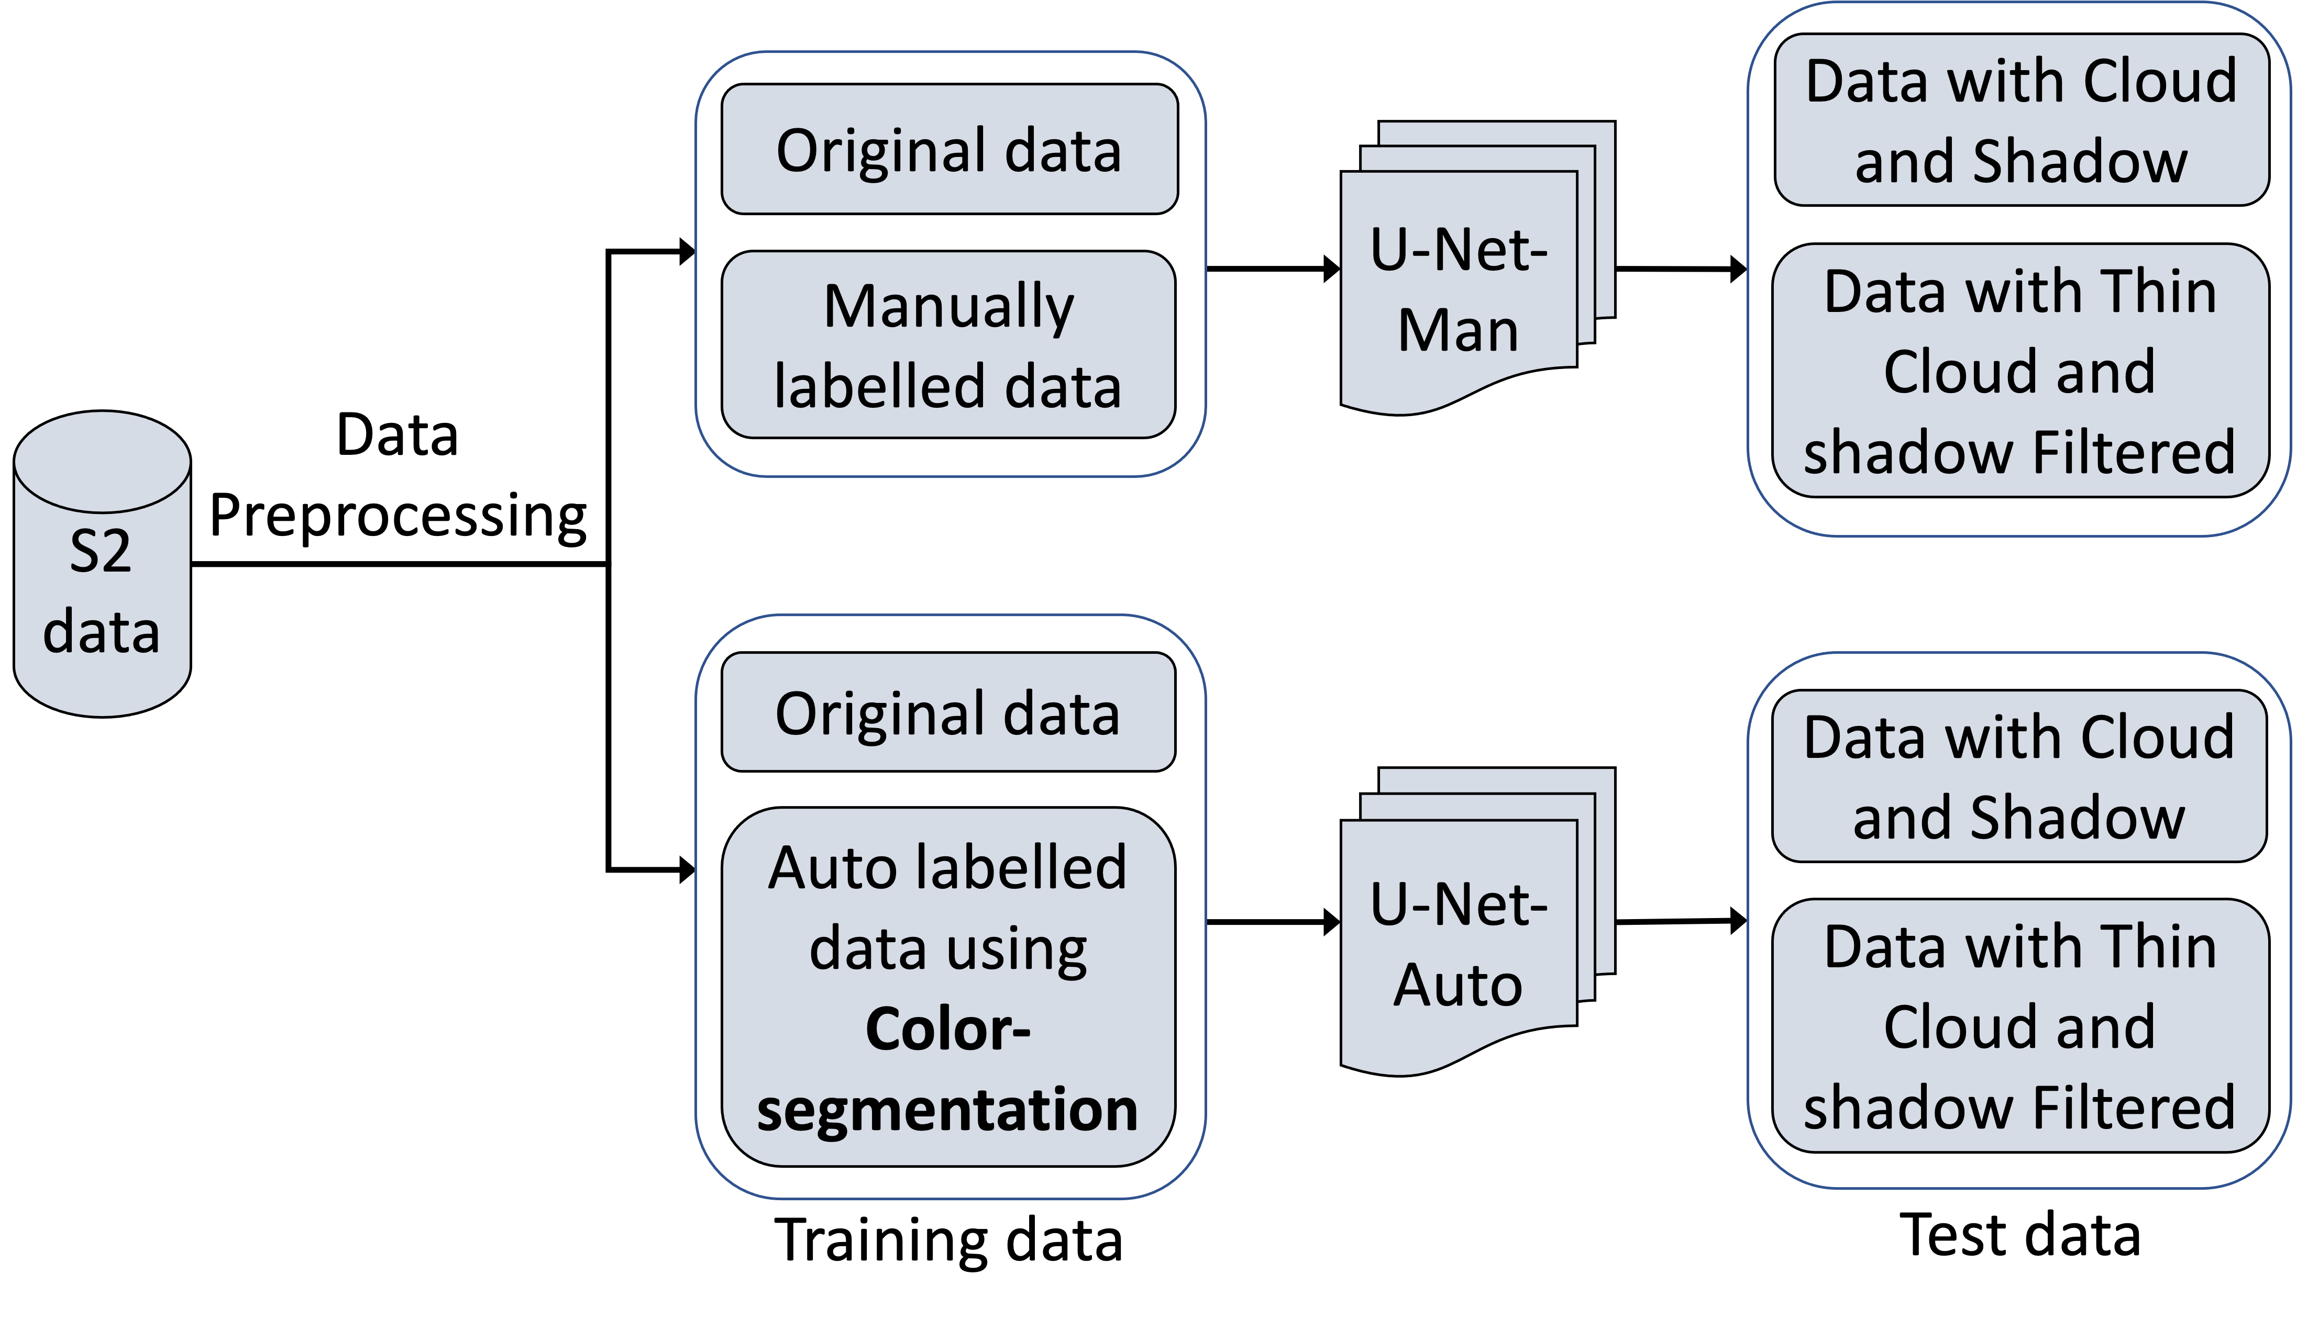
U-Net Classification Training and Testing Workflow
Figure : Sea Ice Classification Workflow
Notes:
Manually labeled data time consuming

Slide 3
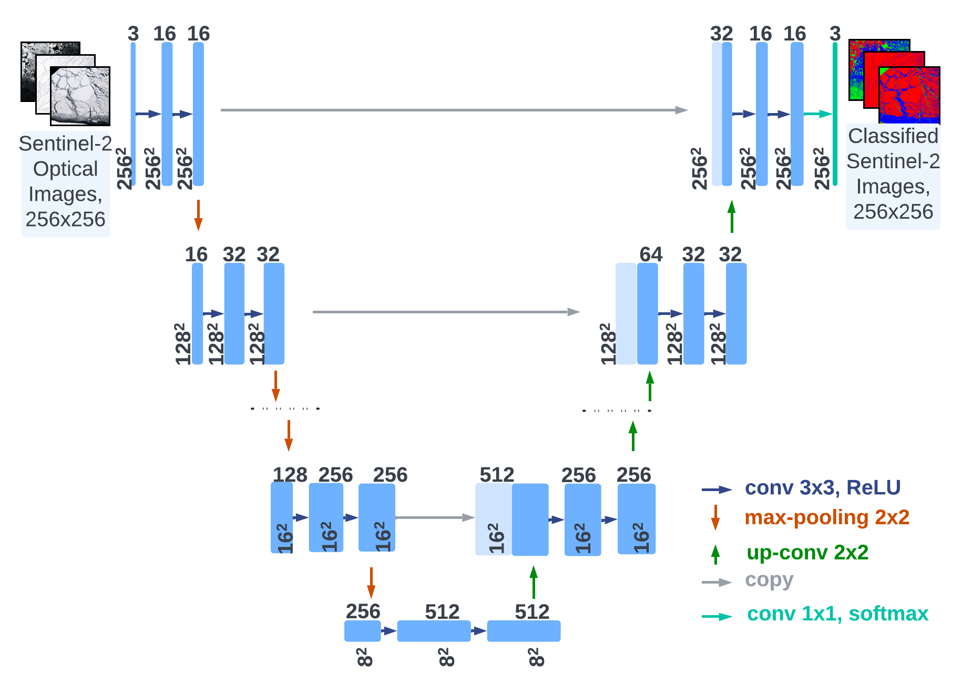
U-Net Architecture
Figure : U-Net model Architecture.

Slide 4
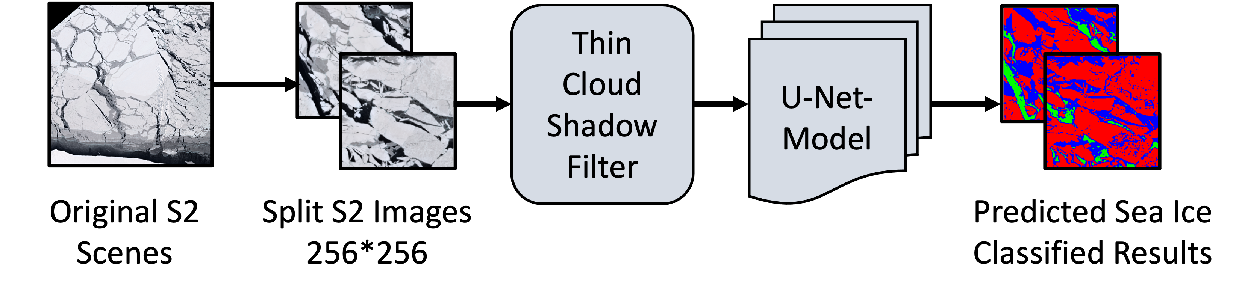
U-Net model Inferencing
Figure: Workflow for Sea Ice Classification employing cloud-shadow filter and U-net model Inferencing.

Slide 5
Horovod Distributed Training
Since training our U-Net model is computationally heavy, we want to focus on distributed training to make it more scalable without losing the accuracy of our model. We applied synchronized data parallelism to scale the U-Net model training on multiple GPUs.
Instead of deploying one or multiple parameter servers, which are part of the built-in distribution strategy in TensorFlow, we opted to utilize Horovod for aggregating and averaging gradients across multiple GPUs.
Horovod is an open-source distributed deep-learning training framework developed by Uber.
It is an open-source distributed training library for TensorFlow, Keras, PyTorch, and Apache MXNet.

Slide 6
Horovod Distributed Training
It enabled us to distribute the U-net model training over multiple GPUs. For efficient inter-GPU communication, it utilizes a ring-based all-reduce algorithm, which has been demonstrated to be bandwidth optimal and avoids system bottlenecks.
MPI is used for coordina ting between the processes in Horovod. The Open-MPI-based wrapper is utilized to execute the Horovod scripts.

Slide 7
Horovod Distributed Training Steps
To integrate our single-GPU implementation with the Horovod-based multiple-GPU distributed training,
We first initialize Horovod using hvd.init() and assign a GPU to each of the TensorFlow processes.
Then we wrap the TensorFlow optimizer with the Horovod optimizer using opt=hvd.DistributedOptimizer(opt).
This Horovod optimizer handles gradient averaging using a ring-based all-reduce mechanism.
Finally, we broadcast initial variable states from rank 0 to all other processes using hvd.callbacks.BroadcastGlobalVariablesCallback(0)

Slide 8
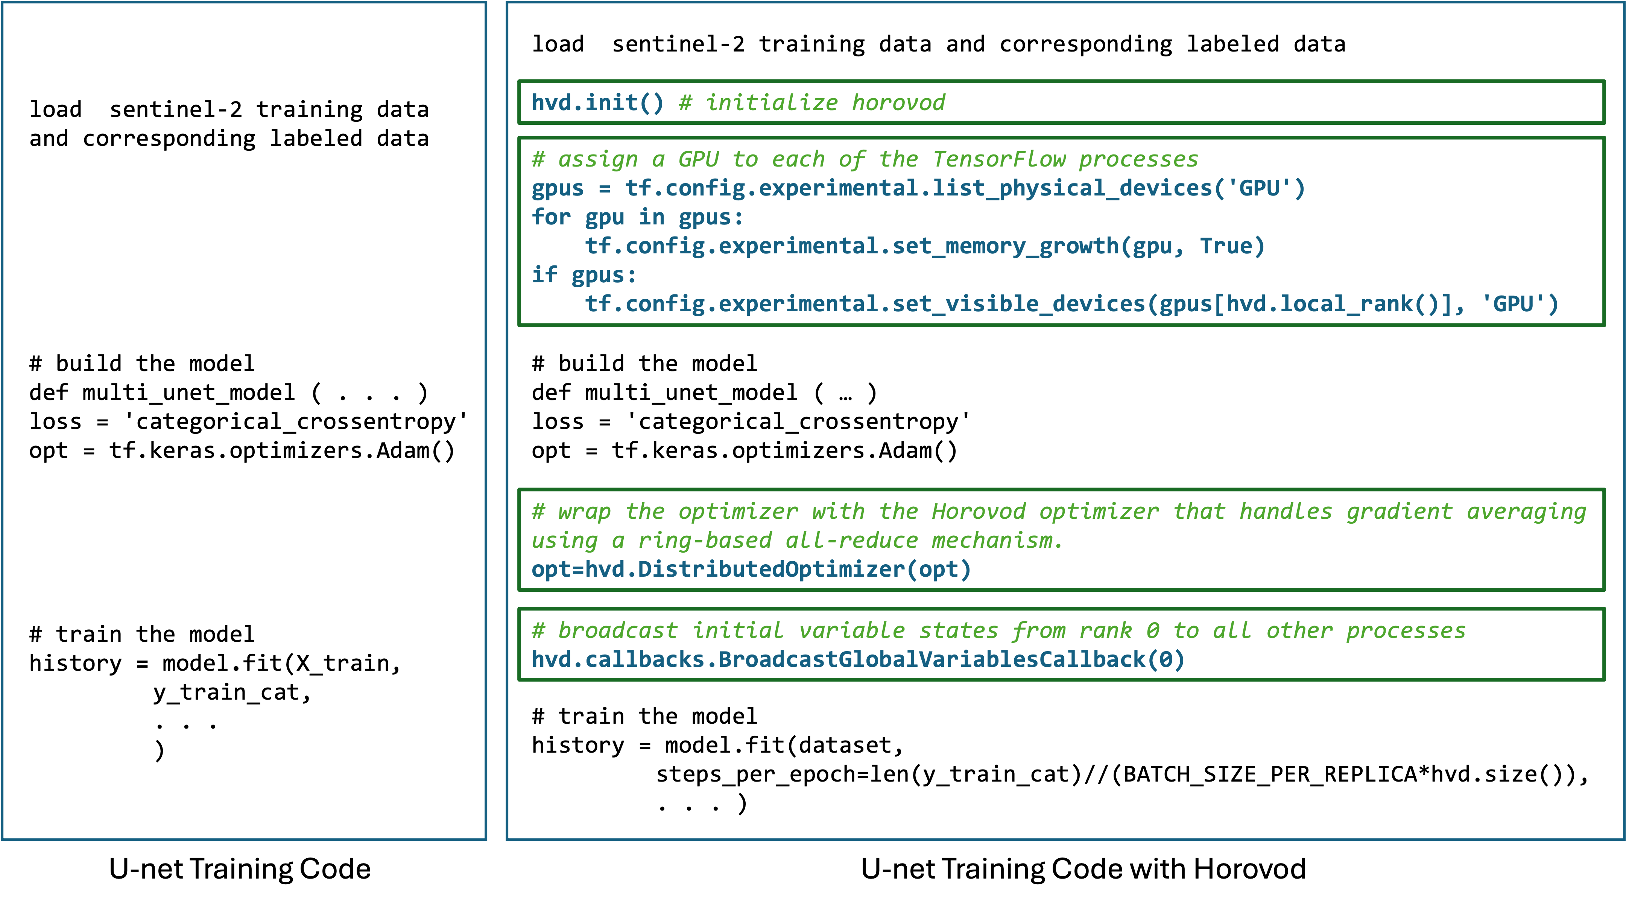
Horovod Distributed Training Code

Slide 9
Horovod Distributed Training Setup
Our U-Net models have a batch size of 32, and the number of epochs is 50 for the results reported in the next section.
Total 4224 , 256x256 S2 images.
Since this U-net training is computationally heavy, we have applied Horovod-based distributed training.
For this, we have utilized an NVIDIA DGX A100 machine with dual CPUs, each with four A100 GPUs.

Slide 10
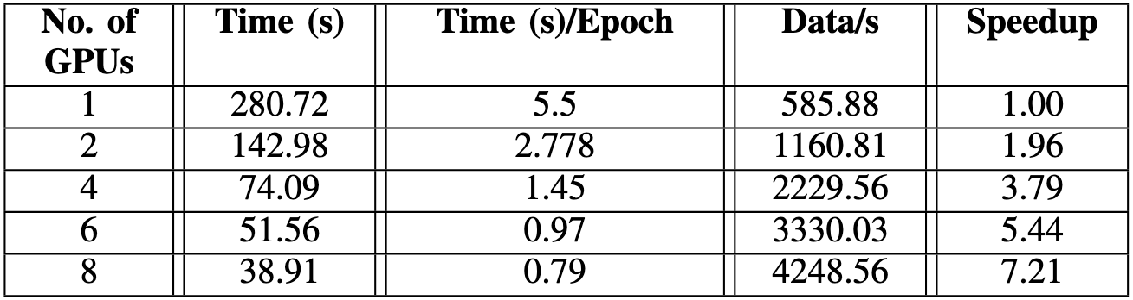
Distributed U-Net model training via Horovod framework
Distributed U-Net model training using Horovod framework on DGX A100 cluster.

Slide 11
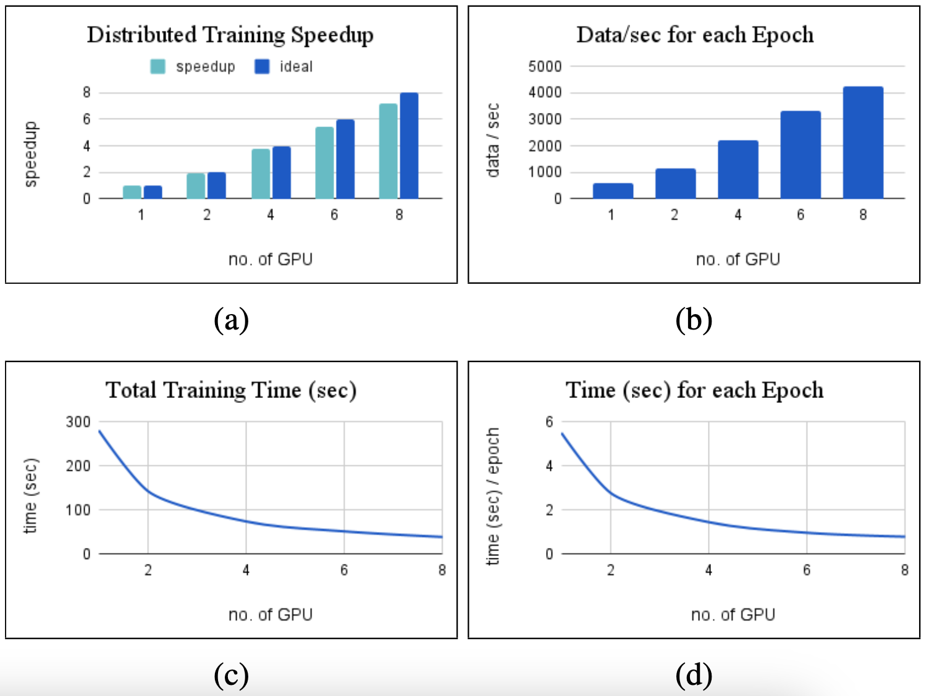
Distributed U-Net model training via Horovod framework
Distributed U-Net model taining via Horovod framework,

Slide 12
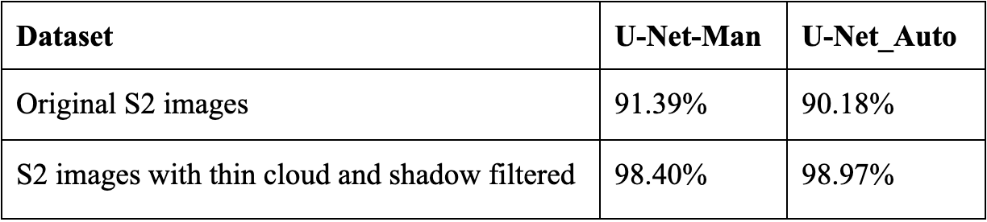
U-Net Model Accuracy
Table: U-Net models sea ice classification accuracy over S2 Antarctic Summer datasets.

Slide 13
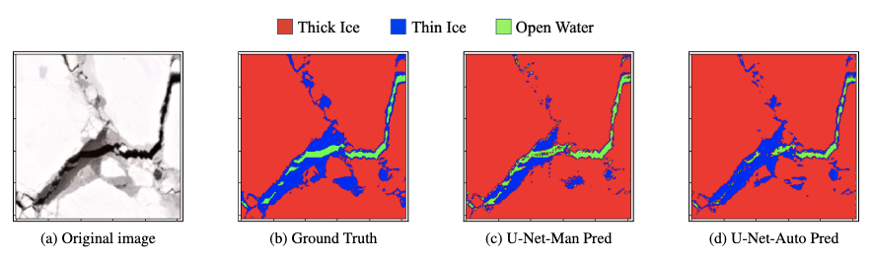
Auto-labeling Validation
Figure: S2 original image and corresponding manually labeled ground truth image compared to U-Net-Man and U-Net-auto model predictions.

Slide 14

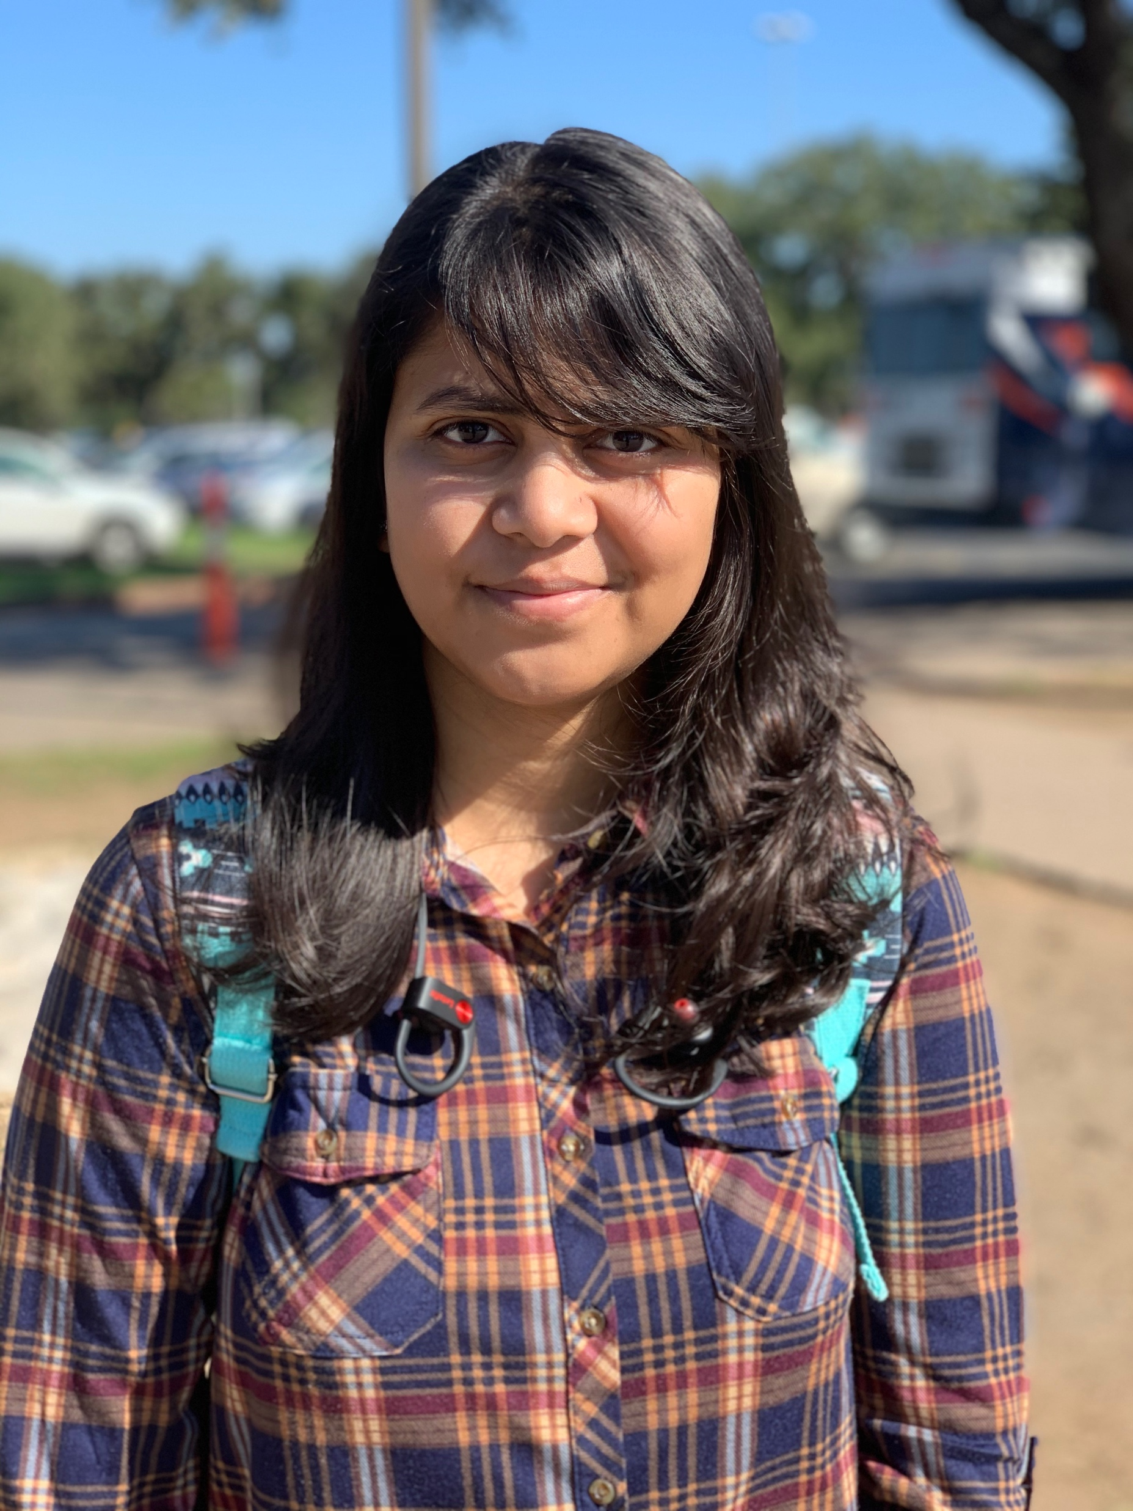
Thank You
Presenter Information:
Jurdana Masuma Iqrah
Ph.D. Candidate
University Of Texas at San Antonio
Email: jurdanamasuma.iqrah@utsa.edu
jurdana.masuma@gmail.com

